Slide 1
Showing Breeding Livestock
Mrs. H (SHS) & Mrs. H (RHS)
(Major Shows Info included)

Slide 2
Breeding Animals
Students may show more than one breeding animal. Breeding animals do not go to auction. Their purpose is to have babies that you will show and sell.
* Rabbits * Sheep
* Beef/Dairy Heifers * Goats

Slide 3
Purchasing Breeding Animals
Students can purchase breeding animals from a breeder of their choice.
Animals must be registered and validated according to breed/species specifications.
Ag teacher will assist with purchasing, registration, and validation processes.
Cost varies GREATLY depending on quality of animal.
Lease options are available for some breeds thru some breeders.

Slide 4
Requirements
You should talk with your teacher before you buy an animal and make sure you have a stall designated for that animals by your teacher.
You should have your stall ready and all of your equipment/feed before you bring your animal to the barn.
Animals should be fed twice a day about 12 hours apart to ensure they are eating enough feed and to ensure you notice an changes in behavior or wellness early.
Always make sure you talk to your teacher before you give your animal any medicine or supplement.

Slide 5
Eligibility
FFA goes by UIL rules for eligibility.
If you do not pass you will not miss school to go to shows.

Slide 6
Show Dates/Entries
Every show has a premium book which has all of the rules, entry dates, entry fees and everything else you need to know about the show.
It is your (student/parent) responsibility to know when entries for shows are due, the entry fees, all forms needed and important dates. Your teacher will help you with this but it is your responsibility to know when things need to be submitted.
https://tinyurl.com/lhcholf
https://tinyurl.com/kqdksos

Slide 7
Quality Counts
Every student must complete the quality counts online quiz.
After you have received an 80 or above you need to print or save the certificate and turn it in to your teacher.
The quiz is over safety in production animals and medications used with production animals.
There are study materials your ag teacher can provide for you.

Slide 8
Quality Counts
Quality Counts Study Material https://tinyurl.com/kucfoce
Go to the page: http://agrilife.org/qualitycounts/verification/
Click the words “Take the test and become Verified”
Click FFA-Fill out info and start the exam.
You have to get an 80%
Print/save and send to Mrs.H!

Slide 9
Validation
To show at major stock shows your animal has to be validated.
Validation is checking animals versus papers and identification.

Slide 10
Validation Dates
Cattle:
$25 and forms due before May 31st
Validation day: June 22 9am at GISD barn
Goats/Sheep:
$25 and forms due before May 31st
Validation day: TBA

Slide 11
Major Show Dates
2017:
State Fair of Texas- 9/29-10/22*
Heart of Texas (Waco)- 10/5-10/14
2018:
Fort Worth Stock Show- 1/12-2/3*
San Angelo Stock Show- early February
Houston Livestock Show- 2/27-3/18*
Austin Livestock Show- mid to late March*

Slide 12
Costs (non-animal)
Feed, Hay and Supplements
Soaps, hair products, combs, brushes
Halter and show halter
Blanket/ body sock (goats and sheep)
Feeder, water bucket, hay bag
Depending on species: other show accessories

Slide 13
Show Costs
Show entries (including any late fees) are due on the date provided by teacher and are the students/parents responsibility.
CATTLE: shavings and hay costs for show will be initially paid for by FFA; the week we get back from the show everyone will be told how much their part is and it will be due at the end of that week.
SHEEP/GOATS: each students will bring 2 bags of shavings (one for the trailer and one for the stall) and hay for their animal(s).

Slide 14
Show Needs
FFA will take the show box and will provide general supplies, brushes and combs for use by all students.
Students need only bring the items listed. I recommend students getting 5 gallon bucket with a lid to keep their show supplies in (not the same bucket used for feed)

Slide 15
Show Needs-Rabbits
Rabbits will need the following things for show:
Travel cage for rabbit- (dog carrier)
5 gallon bucket with lid with name on it in sharpie
Water Dispenser
Feed Dispenser
Bedding material
Feed
Timothy Hay

Slide 16
Show Needs-Cattle
Students are responsible for supplying their feed and supplies for the show. Your name should be on them in sharpie.
You need to bring:
one bag of feed (if we need more than one bag of feed I will let you know)
one bag of beet pulp
feed pan
5 gallon water bucket (flat back bucket)
show stick
5 gallon bucket with lid for supplies:
any supplements you feed
neck tie
show comb
show halter
shampoo

Slide 17
Show Needs-Goats/Sheep
Students are responsible for supplying their feed and supplies for the show. Your name should be on them in sharpie.
You need to bring:
your feed in a 5 gallon bucket with a lid (can be found at Home Depot & Walmart)
5 gallon bucket with lid for supplies:
shampoo
show comb
any supplements you feed
show chain and lead
hay bag full of hay
your feeder
a water bucket

Slide 18
Equipment
Goats/Sheep
Heifers
** The items listed in the following slides are the bare necessities. There are millions of things that you may decide to get and use; your ag teacher is a good resource to decide if it is a need or not and to get an honest review. **

Slide 19
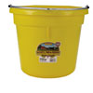
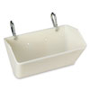
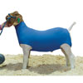
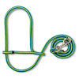
Goats/Sheep
All of these items can be found at a feed store or can be ordered thru your ag teacher. Prices will vary.
Item | Cost | Picture
5-Gallon Flat-Back Plastic Bucket (water) | $ 10
Single Wire Fence Feeder (clips or hooks) | $ 10
Cotton Tube | $ 20
Rope Sheep and Goat Halter with clip | $ 5

Slide 20
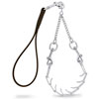
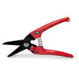
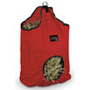
Goats/Sheep
All of these items can be found at a feed store or can be ordered thru your ag teacher. Prices will vary.
Item | Cost | Picture
Pronged (or non pronged) Chain Goat Collar and Lead (GOATS ONLY) | $ 20
Hoof Trimmer | $ 10-20
Hay bag | $ 15-20

Slide 21
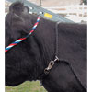
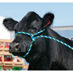
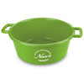
Heifers
All of these items can be found at a feed store or can be ordered thru your ag teacher. Prices will vary.
Item | Cost | Picture
Rope Halter and neck tie | $ 6 each
Feed pan (5 gallon) | $ 15
5-Gallon Flat-Back Plastic Bucket (water) | $ 10
Large water container | $ varies | Something large enough to hold plenty of water for a whole day.

Slide 22
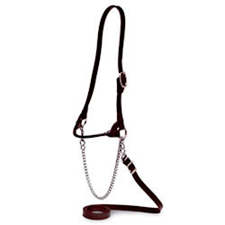
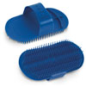
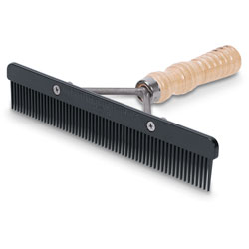
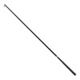
Heifers
All of these items can be found at a feed store or can be ordered thru your ag teacher. Prices will vary.
Item | Cost | Picture
Leather Show Halter | $ 35-45
Wash brush | $ 3-5
Comb | $ 15
Show Stick | $ 20-30

Slide 23
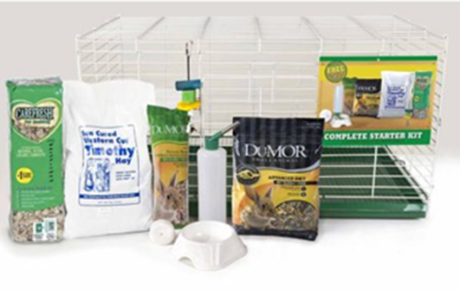
Rabbits
All of these items can be found at a feed store or can be ordered thru your ag teacher. Prices will vary.
Cage with slide out pan for easy cleaning
(You will need one cage per rabbit)
Water Dispenser
Feed Dispenser
Bedding material
Feed
Timothy Hay
Pictured is the Rabbit Starter Kit available at Tractor Supply Co. for $39.99.

Slide 24
Feed/Supplements
Goats: Morman feed and barley
Heifers: MFM Pro Show, cotton seed hull, shredded beet pulp with molasses
Sheep: Jocoby feed
Sudan/Costal/Alfalfa hay depending on your animals needs
Calf Manna supplement (goats and beef heifers)
These are recommendations from your ag teacher, we can help you find feed and can pick up if students decide to buy in bulk together.

Slide 25
Feed/Supplements
Animals at different ages need different feeds.
Young animals will need grower to start and then as they get older you will move them to developer. The different types of feeds have different amounts of protein and such for different needs in life span.
Some of the supplements you can start as soon as you can and some will only be needed near show time to help them keep weight under stress.

